Slide 1

GOVERNMENT COLLEGE OF ENGINEERING BARGur (AUTONOMOUS)
PROJECT TITLE: Image recognition with IBM Cloud visual recognition.
TEAM MEMBERS:
Swetha.S
Sruthi.M.P
Kiruthika.P
Jenifer Suganthi.S
Latha Mangeskar.M.S

Slide 2
PROBLEM STATEMENT:
Design and implement an image recognition system capable of accurately identifying and categorizing objects classification system that accurately identifies and categorizes images of animals into one of ten predefined classes. The goal is to develop a deep learning model that can distinguish between various animals, including dogs, horses, elephants, butterflies, chickens, cats, cows, sheep, spiders, and squirrels. This system will be able to handle single images as well as batches of test images, providing predictions with associated animal labels. The model should be trained to achieve a high level of accuracy in recognizing and classifying animal images.
.

Slide 3
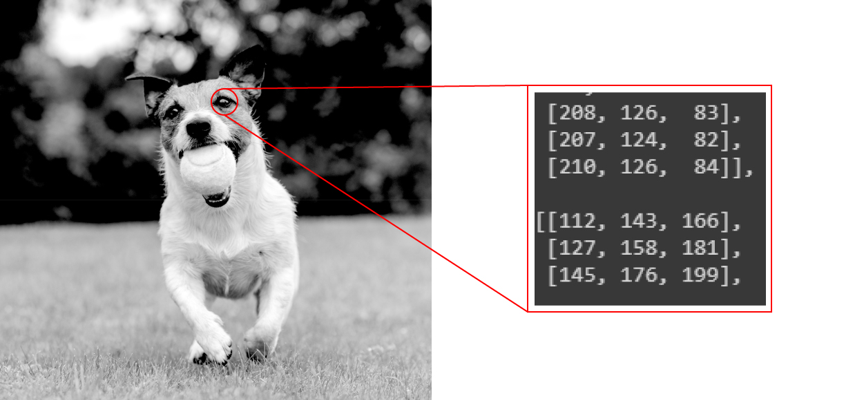
Image recognition:
Image recognition refers to technologies that identify places, logos, people, objects, buildings, and several other variables in digital images. It may be very easy for humans like you and me to recognise different images, such as images of animals.
We can easily recognise the image of a cat and differentiate it from an image of a horse. But it may not be so simple for a computer.

Slide 4
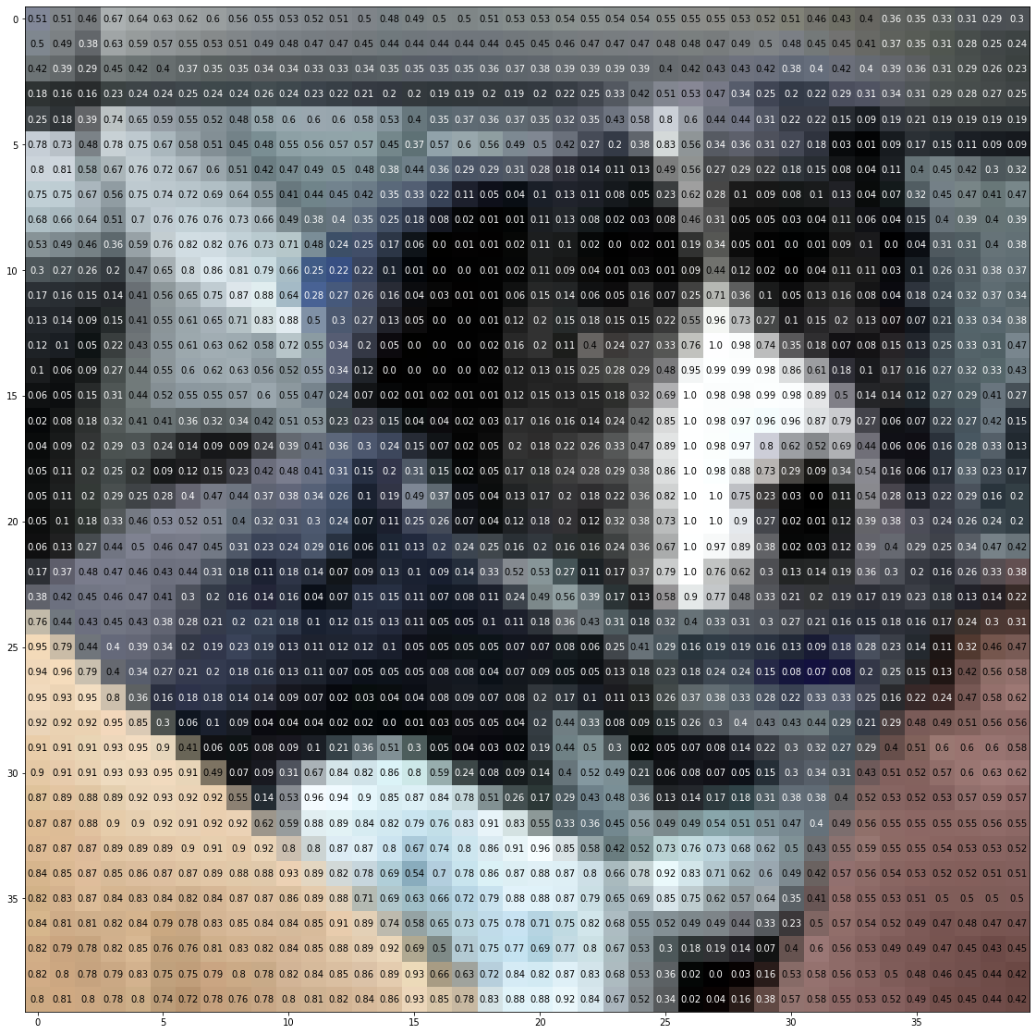
Image recognition:
An image of a dog represented by 40 x 40 pixels.

Slide 5
Working of Image Recognition:
We need a dataset containing images with their respective labels. For example, an image of a dog must be labelled as a dog or something that we can understand.
Next, these images are to be fed into a Neural Network and then trained on them. Usually, for the tasks concerned with images, we use convolutional neural network. These networks consist of convolutional layers and pooling layers in addition to Multilayer perceptron(MLP).
We feed in the image that is not in the training set and get predictions.

Slide 6
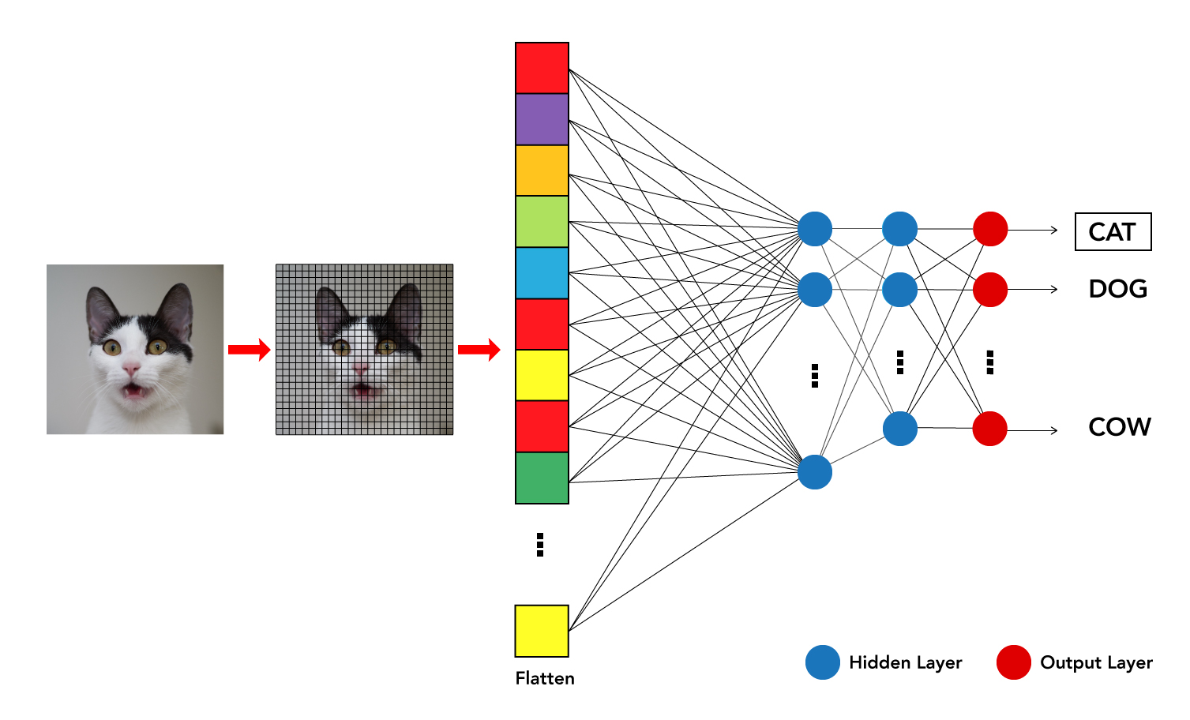
Working of Image Recognition:
For example, a model trained to recognise dogs and cat cannot recognise boats.

Slide 7
PROGRAM:
import tensorflow as tf
from tensorflow.keras.preprocessing.image import ImageDataGenerator
from tensorflow.keras.layers import Input, Dense
from tensorflow.keras import Sequential, Model
from tensorflow.keras.layers import BatchNormalization, Dropout, Flatten
from tensorflow.keras.layers import Conv2D
from tensorflow.keras.layers import MaxPooling2D
from tensorflow.keras.layers import GlobalAveragePooling2D
from tensorflow.keras.applications import MobileNet
from tensorflow.keras.applications.mobilenet import preprocess_input, decode_predictions
from tensorflow.keras.optimizers import Adam
import numpy as np
import os
from PIL import Image

Slide 8
import requests
import io
import cv2
import argparse
def load_and_compile_model():
# Load a pre-trained model (MobileNet in this case)
base_model = MobileNet(weights='imagenet', include_top=False, input_shape=(128, 128, 3))
x = base_model.output
x = GlobalAveragePooling2D()(x)
x = Dense(1024, activation='relu')(x)
x = Dropout(0.5)(x)
predictions = Dense(10, activation='softmax')(x)
model = Model(inputs=base_model.input, outputs=predictions)
# Freeze the layers in the base model
for layer in base_model.layers:
layer.trainable = False

Slide 9
# Compile the model
model.compile(optimizer=Adam(lr=0.001), loss="categorical_crossentropy", metrics=["accuracy"])
return model
def main(train_data_dir, test_data_dir, model_save_path, nb_epochs=20):
# Data augmentation
train_datagen = ImageDataGenerator(
rescale=1. / 255,
shear_range=0.2,
zoom_range=0.2,
horizontal_flip=True,
validation_split=0.2
)
# Load and split data
train_generator = train_datagen.flow_from_directory(
train_data_dir,
target_size=(128, 128),
batch_size=64,
class_mode='categorical',
subset='training‘ )

Slide 10
validation_generator = train_datagen.flow_from_directory(
train_data_dir,
target_size=(128, 128),
batch_size=64,
class_mode='categorical',
subset='validation'
)
# Load or create the model
if os.path.exists(model_save_path):
model = tf.keras.models.load_model(model_save_path)
else:
model = load_and_compile_model()
# Train the model
model.fit(train_generator, epochs=nb_epochs, validation_data=validation_generator)

Slide 11
# Save the model for later use
model.save(model_save_path)
# Function for recognizing images
def recognize_image(image_path):
img = Image.open(image_path)
img = img.resize((128, 128))
x = np.array(img)
x = np.expand_dims(x, axis=0)
x = preprocess_input(x)
prediction = model.predict(x)
labels = decode_predictions(prediction, top=3)[0]
return labels
# Recognize images from the test data
files = sorted(os.listdir(test_data_dir))

Slide 12
for img_name in files:
img_path = os.path.join(test_data_dir, img_name)
labels = recognize_image(img_path)
print(f"Image: {img_name}")
for label in labels:
print(f"Label: {label[1]}, Probability: {label[2] * 100:.2f}%")
print()
# You can also recognize an image from the web by providing its URL
def recognize_image_url(image_url):
response = requests.get(image_url)
img = Image.open(io.BytesIO(response.content))
img = img.resize((128, 128))
x = np.array(img)
x = np.expand_dims(x, axis=0)
x = preprocess_input(x)
prediction = model.predict(x)
labels = decode_predictions(prediction, top=3)[0]
return labels

Slide 13
image_url = "https://d1m75rqqgidzqn.cloudfront.net/kaggle/input/testttt/OIF-e2bexWrojgtQnAPPcUfOWQ.jpeg"
labels = recognize_image_url(image_url)
print("Image from URL:")
for label in labels:
print(f"Label: {label[1]}, Probability: {label[2] * 100:.2f}%")
if __name__ == '__main__':
parser = argparse.ArgumentParser(description="Image Recognition Model")
parser.add_argument("--train_data_dir", type=str, help="Path to training data directory")
parser.add_argument("--test_data_dir", type=str, help="Path to test data directory")
parser.add_argument("--model_save_path", type=str, help="Path to save or load the model")
parser.add_argument("--nb_epochs", type=int, default=20, help

Slide 14
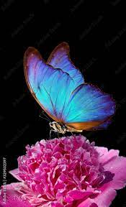
OUTPUT:
Image: butterfly.jpg
Label: Morph butterfly, Probability: 98.2%
Label: Insect, Probability: 9.72%
Label: Moth, Probability: 2.21%

